Slide 1
Machine Learning
Machine Learning Introduction to Machine Learning by Kumar Anurupam is licensed under a Creative Commons Attribution-4.0 International License.
Regression – Regularization
CS 3104 Fall 2019
Lecture Slides by Kumar Anurupam

Slide 2
Learning Outcome
After the completion of today’s session you will be able to:
Explain the concept of regularization.
Illustrate how ridge and lasso regression helps in regularization.

Slide 3
Agenda
Normal distribution
Confidence interval

Slide 4
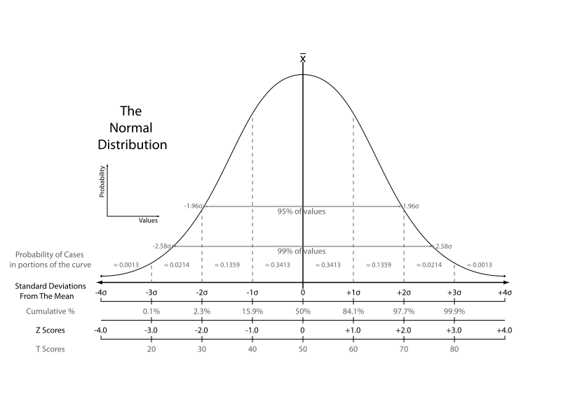
Normal distribution

Slide 5
Confidence interval – idea
Suppose want to calculate the average age of students in the class.
Sample mean age(from a random sample), x̄ = 20
Point estimate: It is a single value, statistic, computed from sample data, and used to estimate a population parameter.
Point estimate can’t really tell how good it represents a population, so we need some kind of interval to overcome this problem
Example:
Point estimate of population mean μ

Slide 6
Confidence Level
It is the percentage of confidence intervals that we expect to contain the population parameter.
Often used confidence level are 90%, 95%(most common) and 99%.

Slide 8
Summary
Regularization can be used to overcome the problem of overfitting.
Penalty can be added and with some severity to reduce the problem of overfitting.

Slide 9
References
[1] https://towardsdatascience.com/regularization-in-machine-learning-76441ddcf99a

Slide 10
Thanks

